Slide 1
CSE 305 Project -e-commerce enterprise
XiangYing Liu ; Zhiyong Jing ; Lei Song

Slide 2
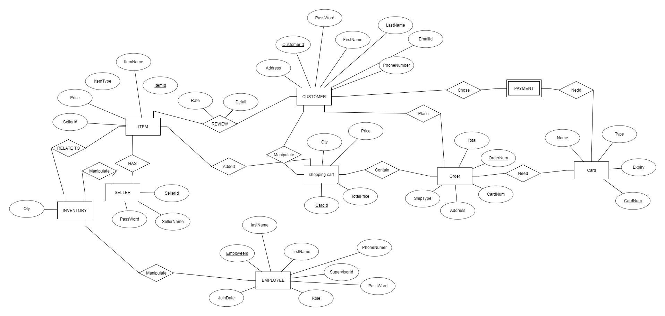
Our ER diagram:

Slide 3
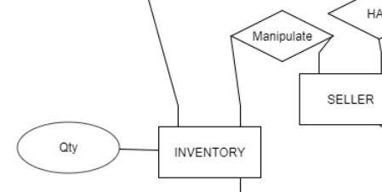
ER diagram – inventory
CREATE INVENTORY(
ItemID CHAR(6) NOT NULL,
Qty INT NOT NULL,
SellerId CHAR(6) NOT NULL,
PRIMARY KEY (ItemId, SellerId),
FOREIGN KEY (ItemId,SellerId) REFERENCES ITEM,
CHECK (Qty > 0))

Slide 4
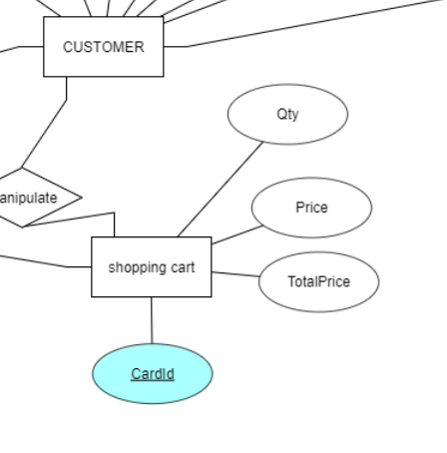
ER diagram – shopping cart and constraint
ER-diagram(pk: itemid, sellerid, customerId)
CREATE TABLE CART(
CardId DATETIME NOT NULL,
CustomerId VARCHAR(20) NOT NULL,
ItemId CHAR(6) NOT NULL,
SellerId CHAR(6), NOT NULL,
Price DOUBLE NOT NULL,
TotalPrice CHAR(6) NOT NULL,
PRIMARY KEY (CardId, CustomerId),
FOREIGN KEY (CustomerId) REFERENCES Customer,
CHECK (Price > 0) )

Slide 5
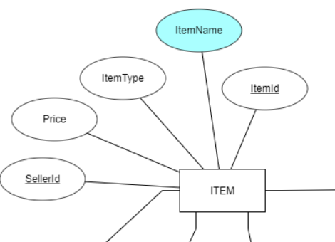
ER diagram – items
CREATE TABLE ITEM(
ItemId CHAR(6) NOT NULL,
ItemName VARCHAR(20) NOT NULL,
ItemType VARCHAR(20) NOT NULL,
Price DOUBLE NOT NULL,
SellerId CHAR(6) NOT NULL,
PRIMARY KEY (ArticleId,SellerId),
FOREIGN KEY (SellerId) REFERENCES SELLER,
CHECK (Price > 0) )
ER- diagram

Slide 6
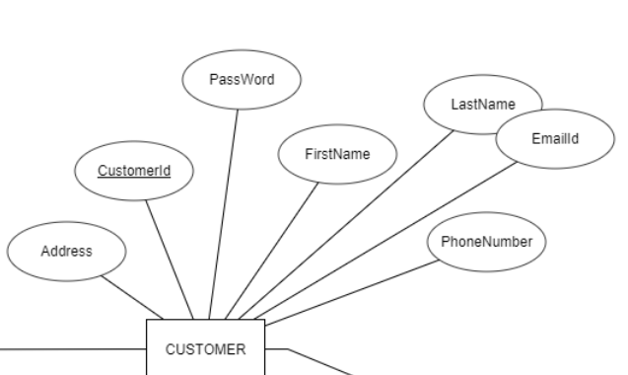
ER diagram – Customer
CREATE TABLE CUSTOMER(
CustomerId VARCHAR(20),
FirstName VARCHAR(20) NOT NULL,
LastName VARCHAR(20)NOT NULL,
EmailId VARCHAR(20) NOT NULL,
PhoneNumber CHAR(12) NOT NULL,
Address VARCHAR(45) NOT NULL,
PassWord VHARCHAR(20), NOT NULL
PRIMARY KEY (CustomerId) )
ER diagram

Slide 7
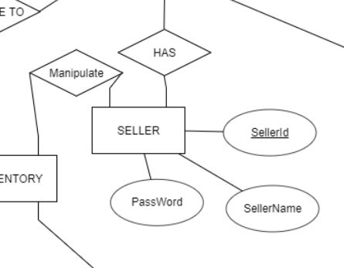
ER diagram – SELLER
ER diagram
CREATE TABLE SELLER(
SellerId CHAR(6),
SellerName VARCHAR(20) NOT NULL,
PassWord VARCHAR(20)NOT NULL,
PRIMARY KEY (CustomerId) )

Slide 8
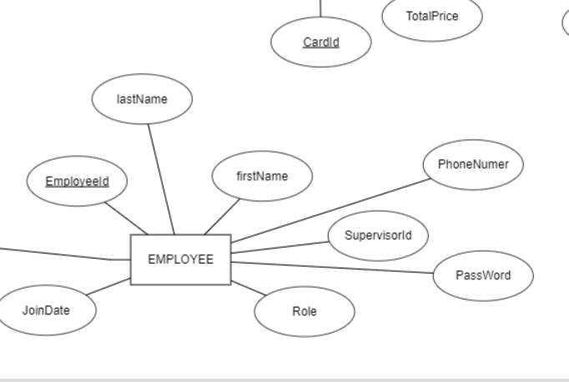
ER diagram – Employee
CREATE TABLE Employee(
EmployeeId CHAR(6),
LastName VARCHAR(20) NOT NULL,
FastName VARCHAR(20) NOT NULL,
PhoneNumber CHAR(12) NOT NULL,
JoinData Date NOT NULL,
PassWord VARCHAR(20) NOT NULL,
PhoneNumber VARCHAR(20) NOT NULL,
SupervisorId CHAR(6) NOT NULL
PRIMARY KEY (EmployeeId) )

Slide 9
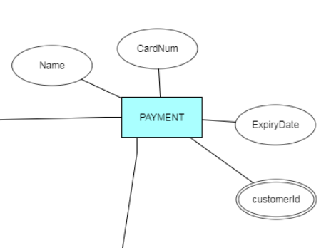
ER diagram – payment
CREATE TABLE PAYMENT(
PaymentType VARCHAR(20) NOT NULL,
CardNumber CHAR(16) NOT NULL,
CardExpirDate CHAR(5) NOT NULL,
PRIMARY KEY (CardNUmber),
CHECK(PaymentType IN(‘Debit’,’Credit’,’PayPal')) )

Slide 10
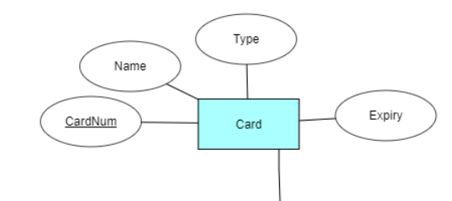
ER diagram – CARD
CREATE TABLE CARD(
CardNum CHAR(10) NOT NULL,
Name VARCHAR(2-) NOT NULL,
Expiry CHAR(5) NOT NULL,
PRIMARY KEY (CardNum),
CHECK(PaymentType IN(‘Debit’,’Credit’,’PayPal')) )

Slide 11
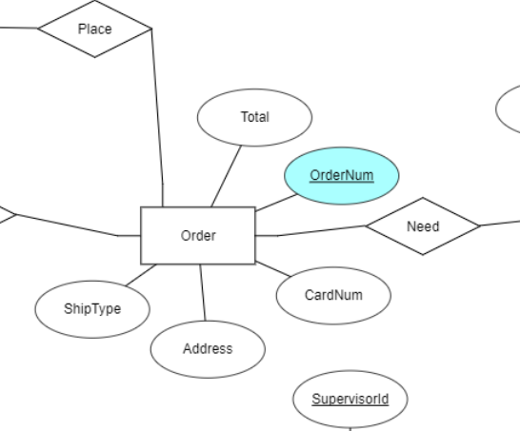
ER diagram –ORDER
CREATE TABLE ORDER(
OrderNum INT NOT NULL,
CartId DATETIME NOT NULL,
CustomerId VARCHAR(20) NOT NULL,
CardNum CAHR(11), NOT NULL,
Address VHARCHAR(45), NOT NULL,
ShipType VARCHAR(20), NOT NULL,
PRIMARY KEY (OrderNum),
FOREIGN KEY (CardId,CustomerId) REFERENCES CART,
FOREIGN KEY (CardNum) REFERENCES CARD) )

Slide 12
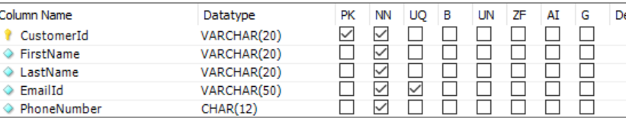
Data base table for customers

Slide 13
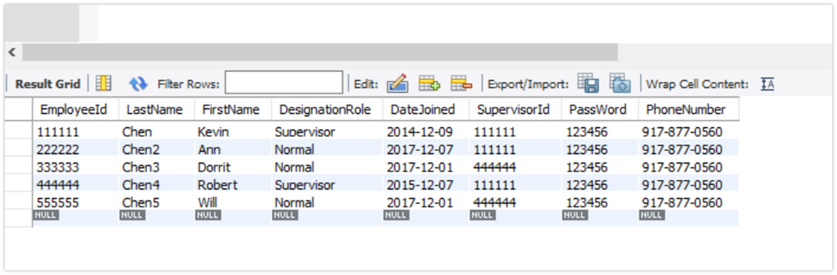
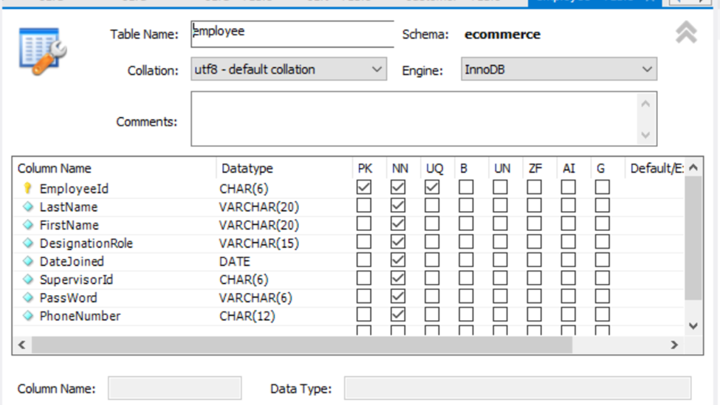
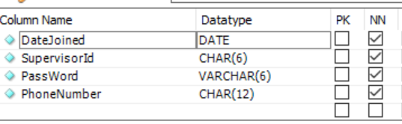
Table for employee
Pk: primary key ; NN: not null
UQ: unique

Slide 14
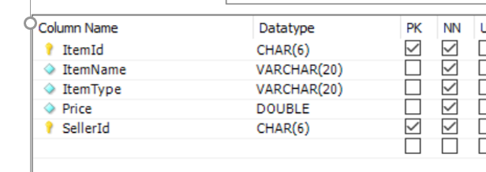
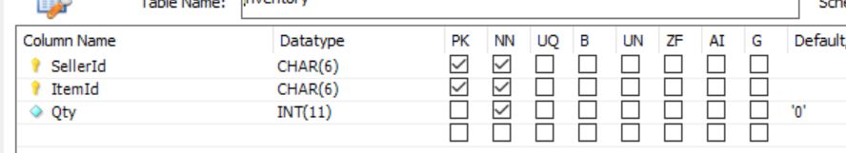
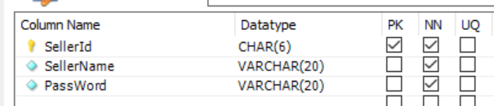
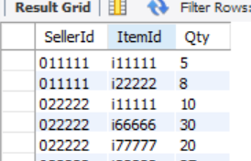
Table for item and seller ,inventory

Slide 15
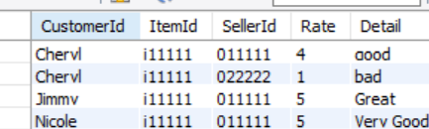
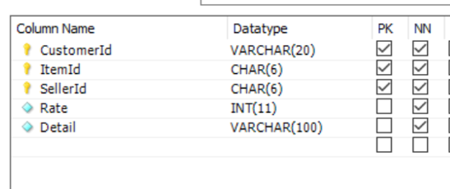
Table for review

Slide 16
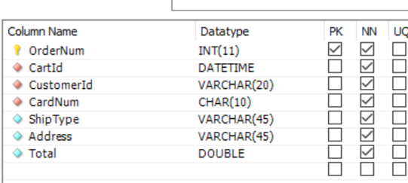
Table for order

Slide 17
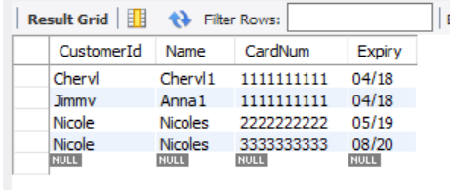
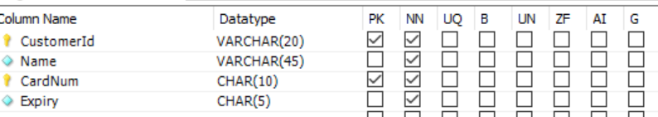
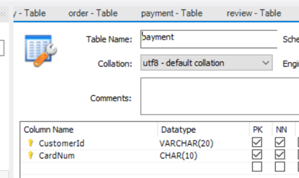
Table for payment/ cart

Slide 18
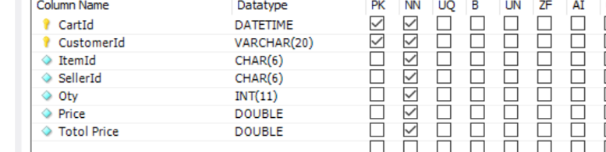
Table for cart

Slide 19
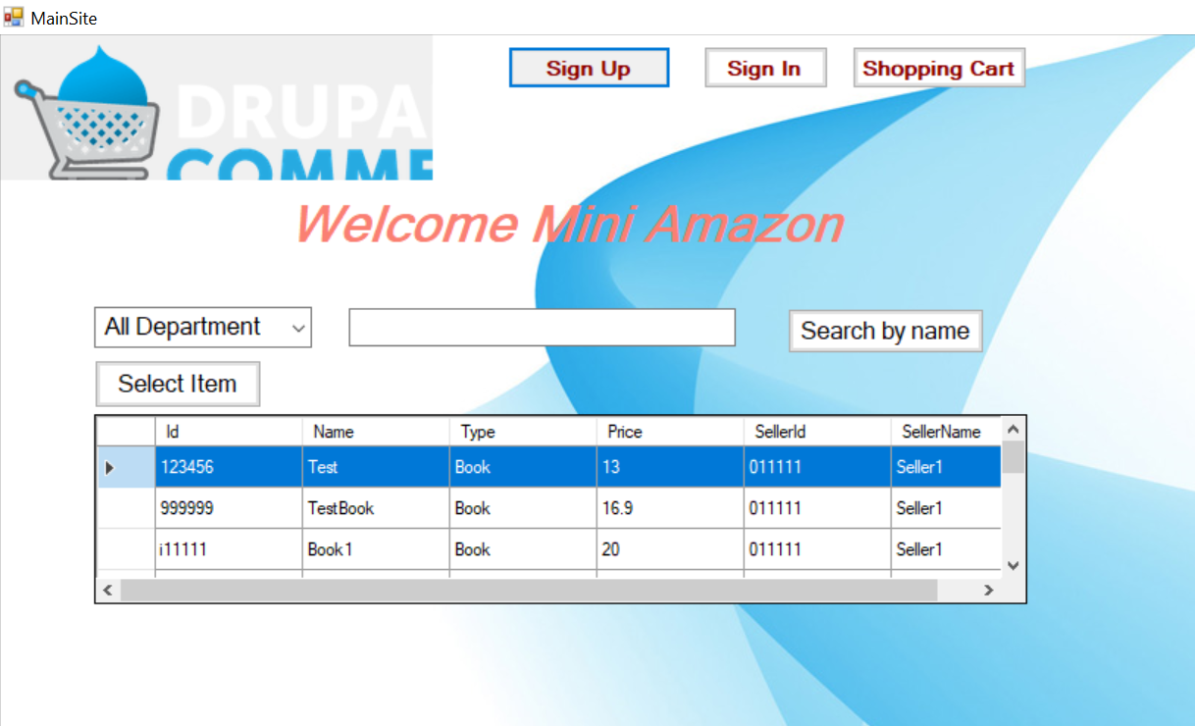
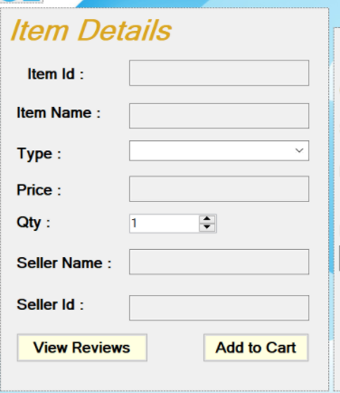
transaction for checking item(guest , customer)
Main page
Item page

Slide 20
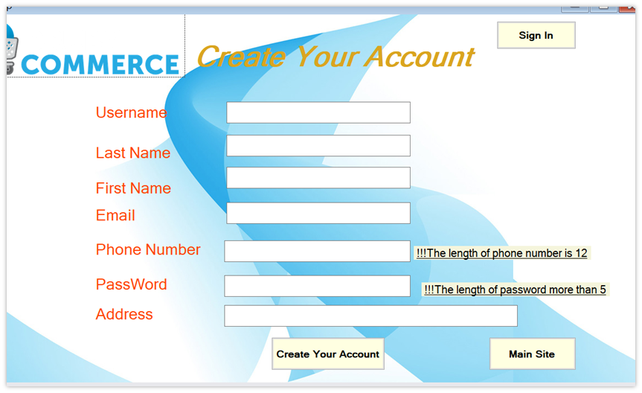
Transaction for sign up(guest)
Sign up button
Sign up page

Slide 21
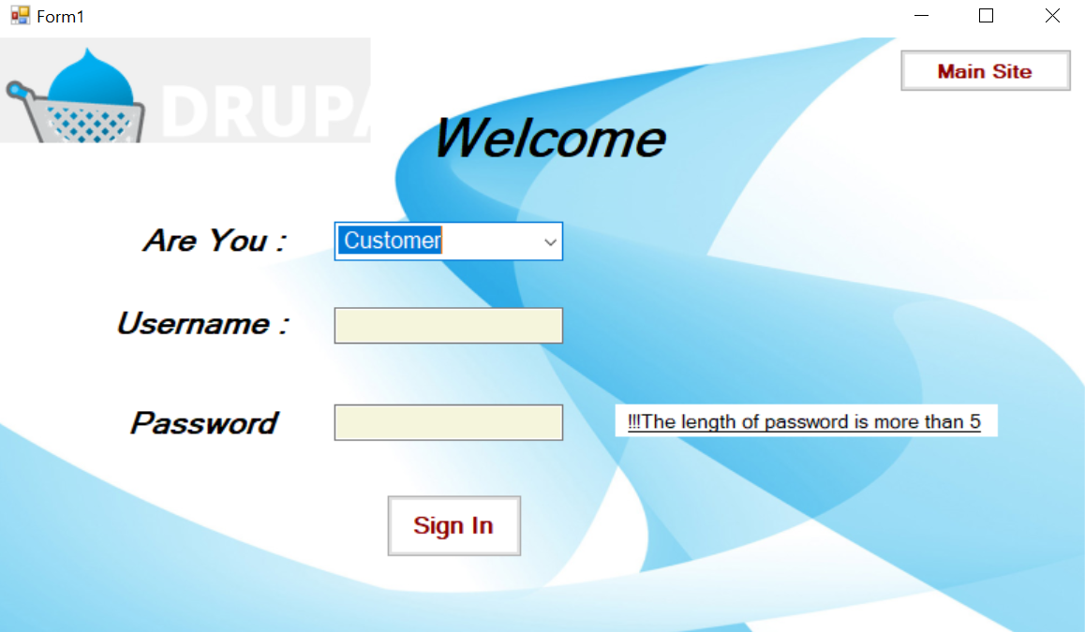
Transaction for sign in (customer)

Slide 22
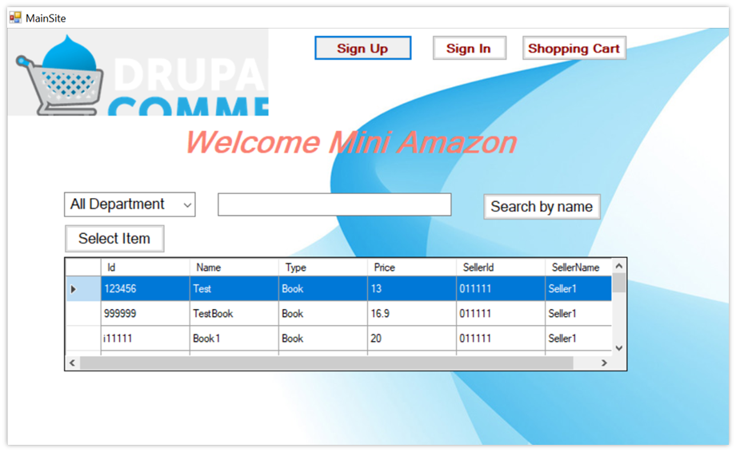
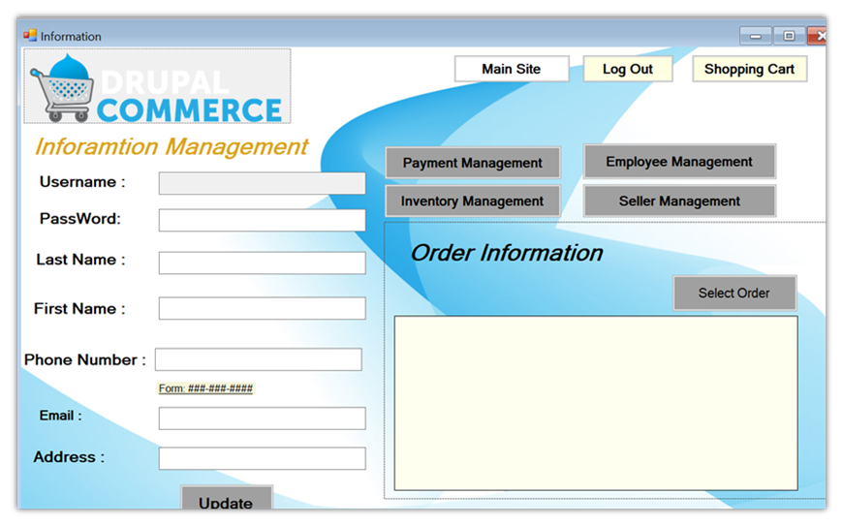
Transaction for checking self infor (customer)
account

Slide 23
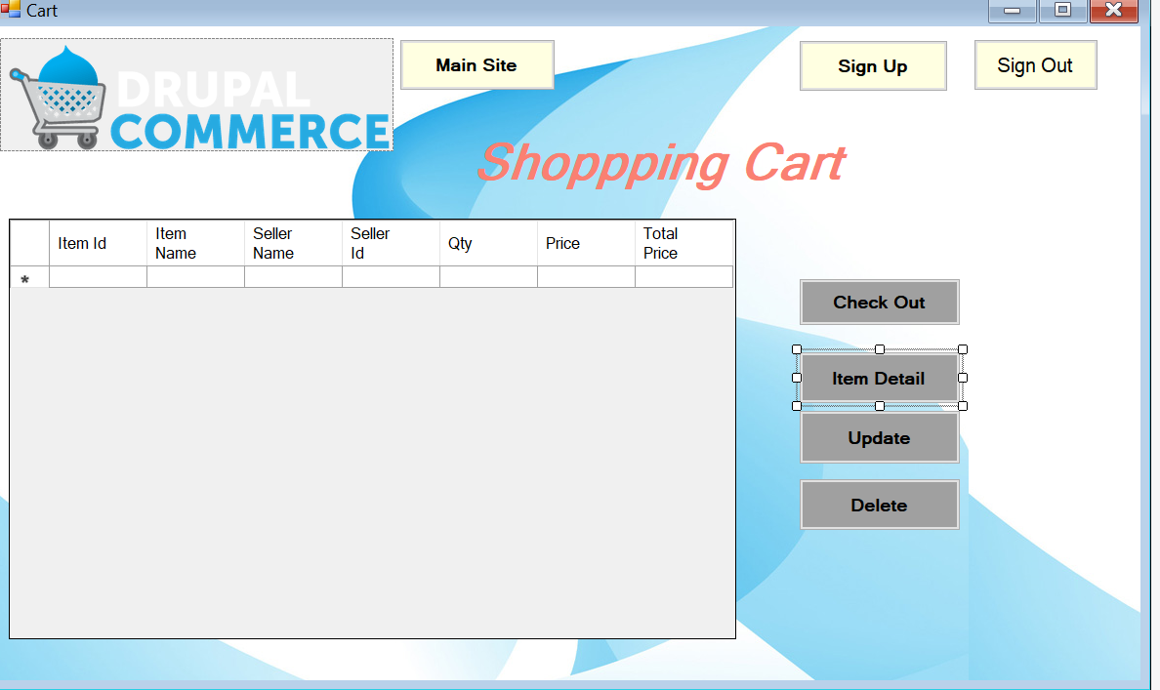

Transaction shopping cart (customer, guest)

Slide 24
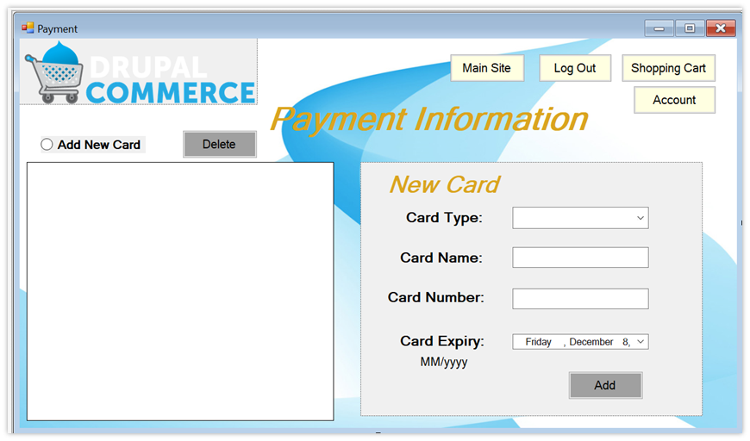
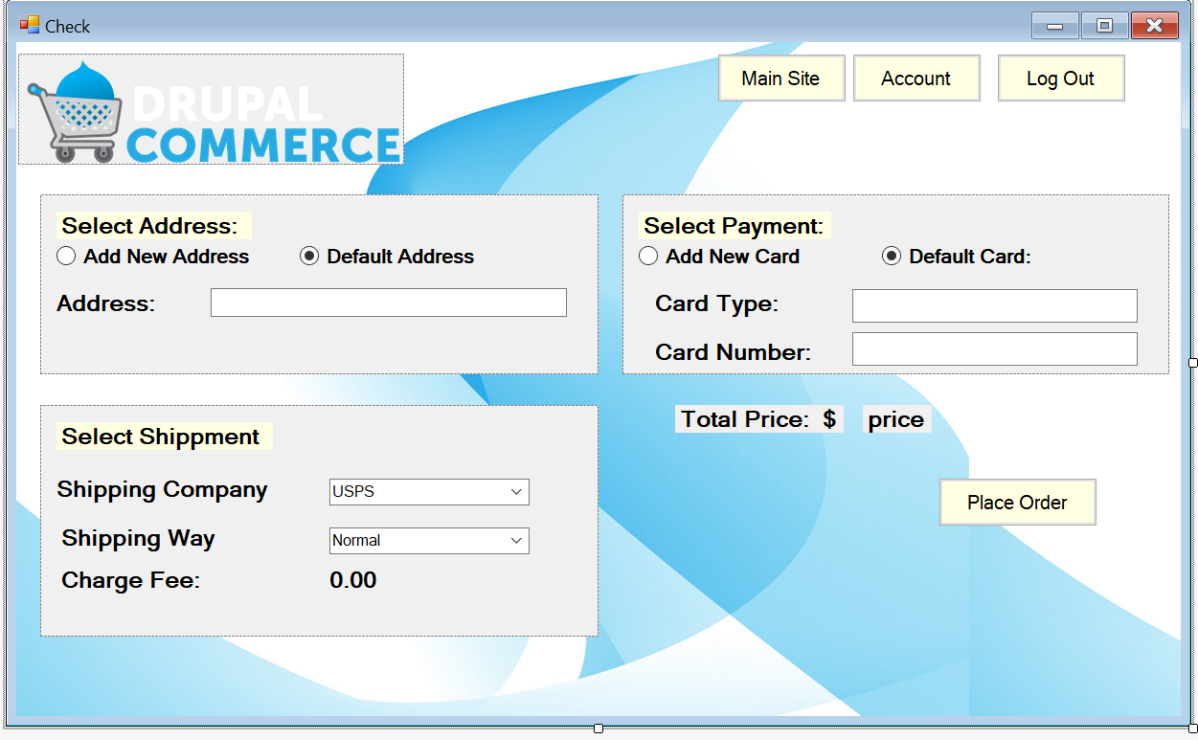
Transaction for check out(customer)

Slide 25
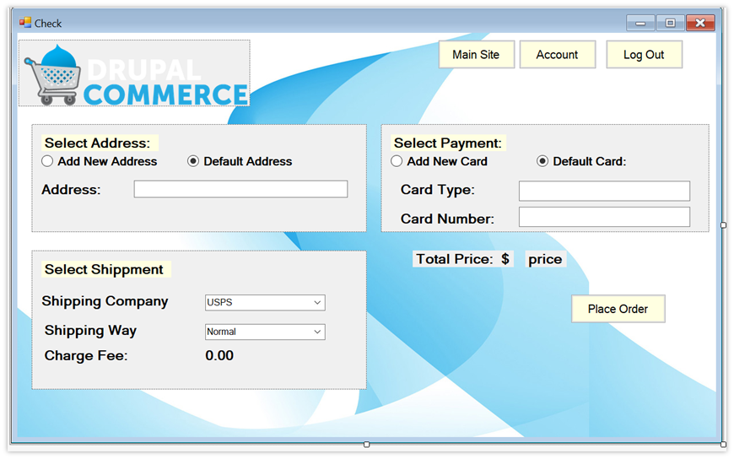
Transaction for payment for check out (customer)

Slide 26
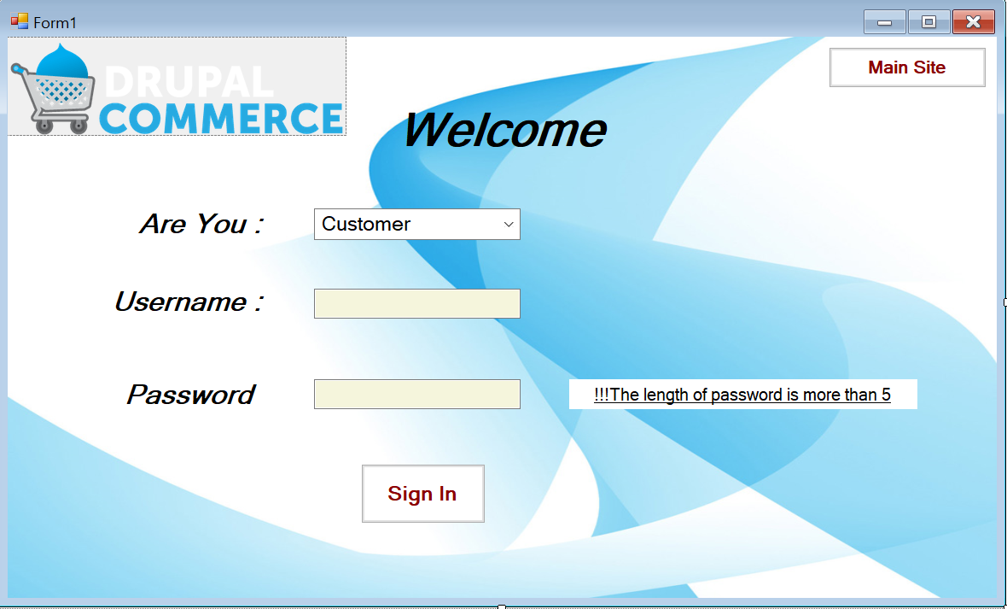
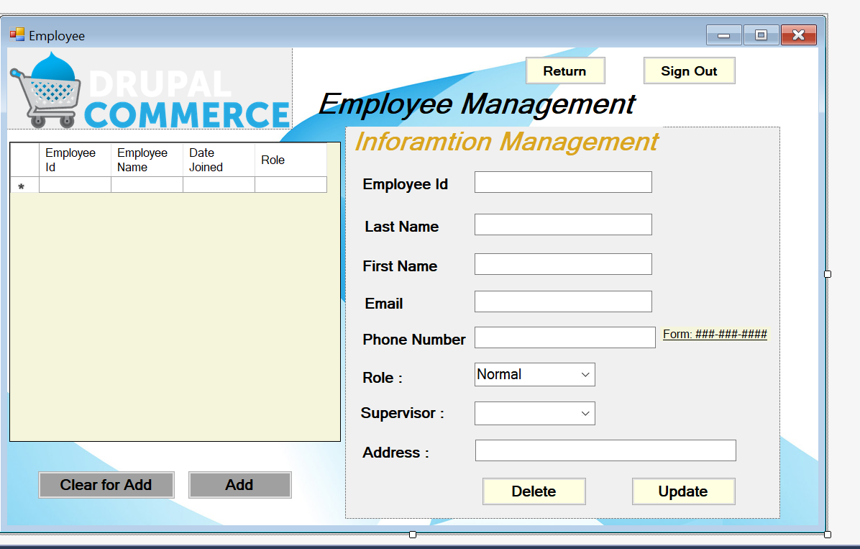
Transaction for supervisor(employee, supervisor)

Slide 27
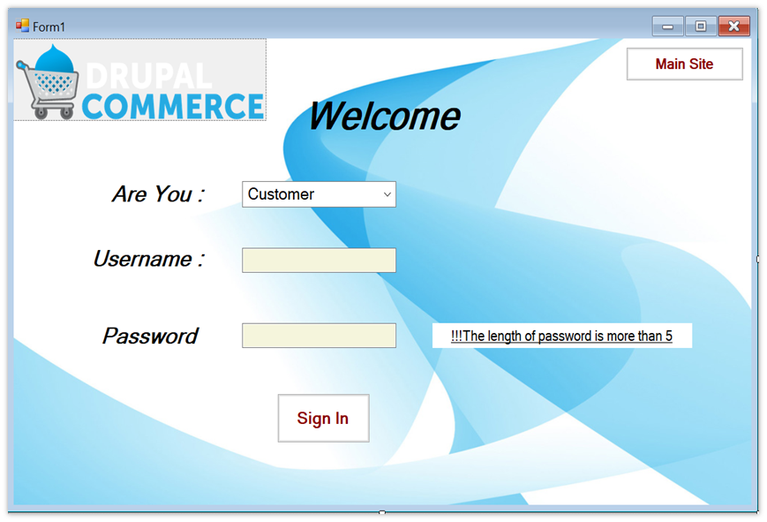
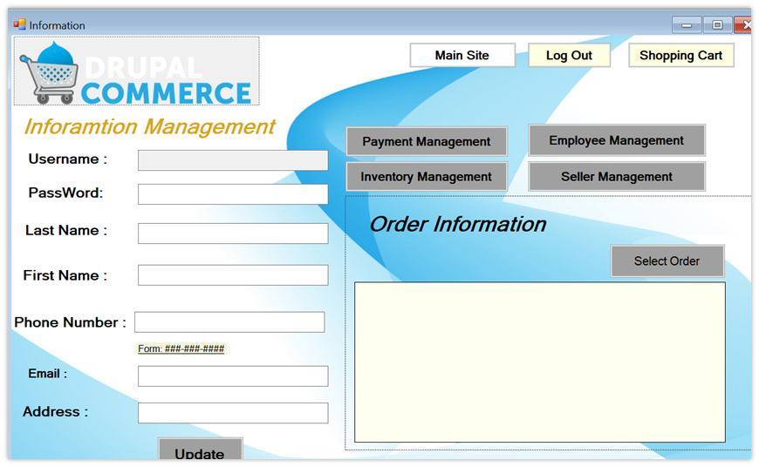
Transaction for employee(employe)

Slide 28
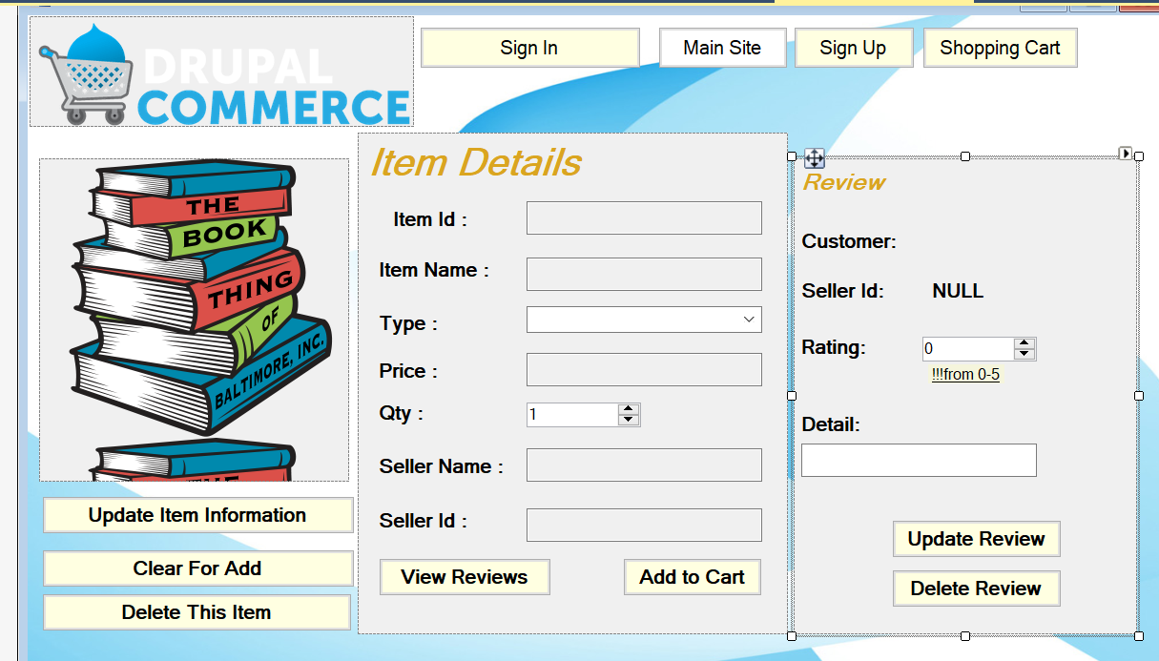
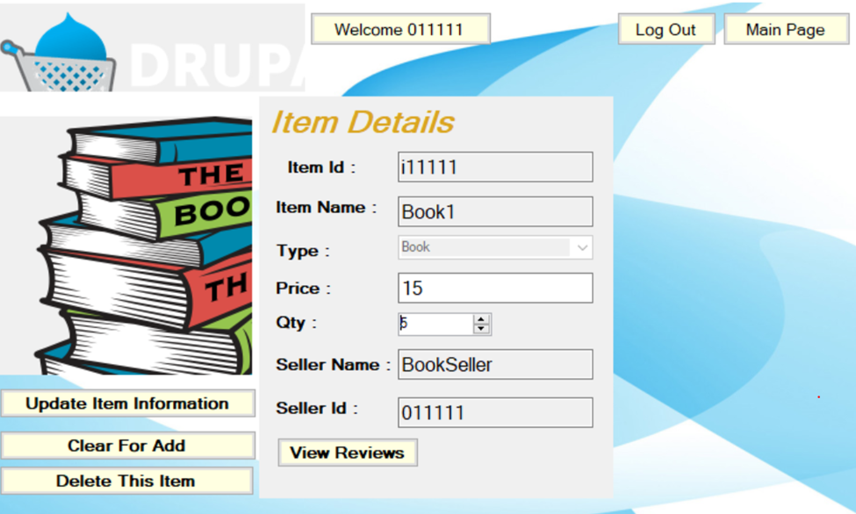
Transaction to update inventory (employee, supervisor, seller)

Slide 29

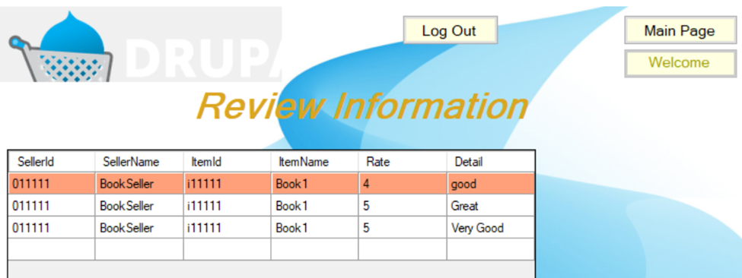
Transaction to check review(customer, seller)

Slide 30
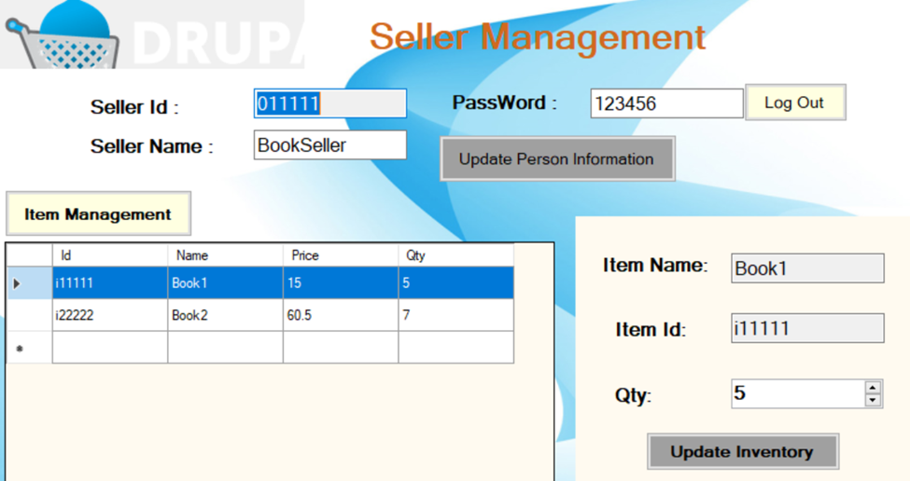
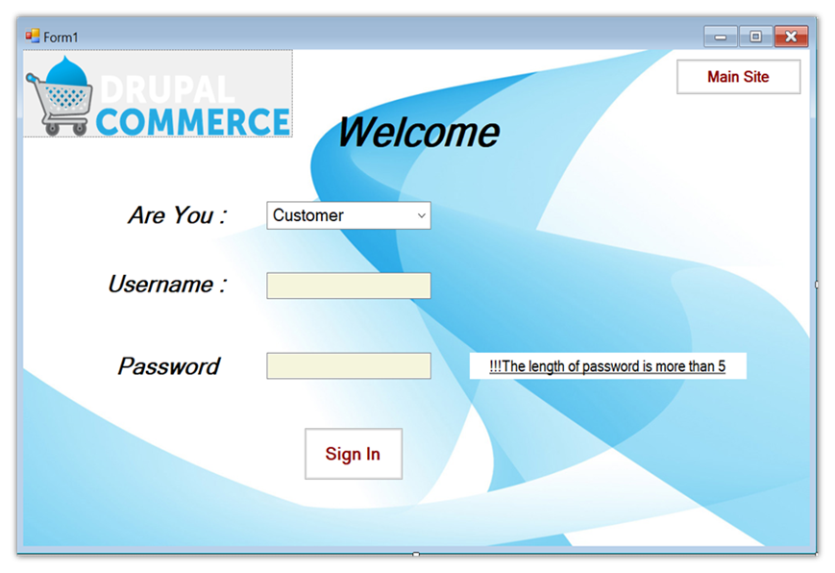
Transaction for update seller info(employee , seller)

Slide 31
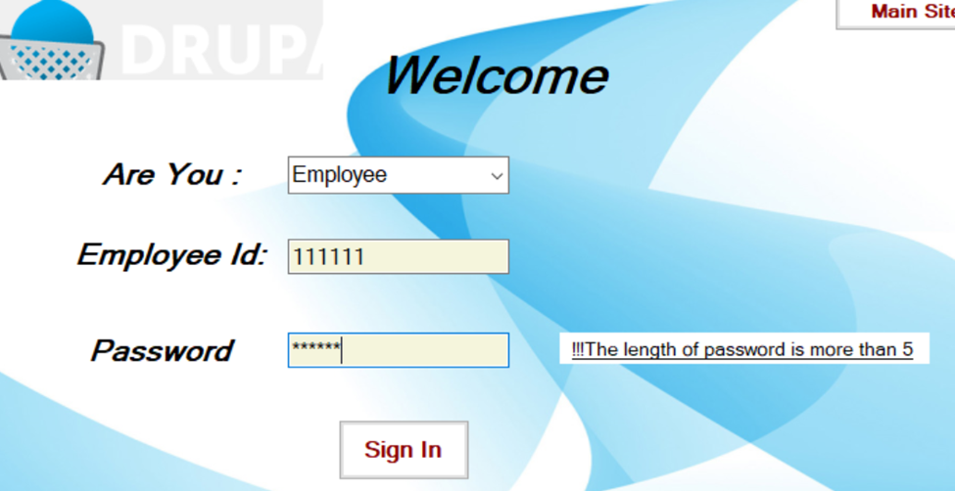
Transaction for update employee(supervisor)

Slide 32
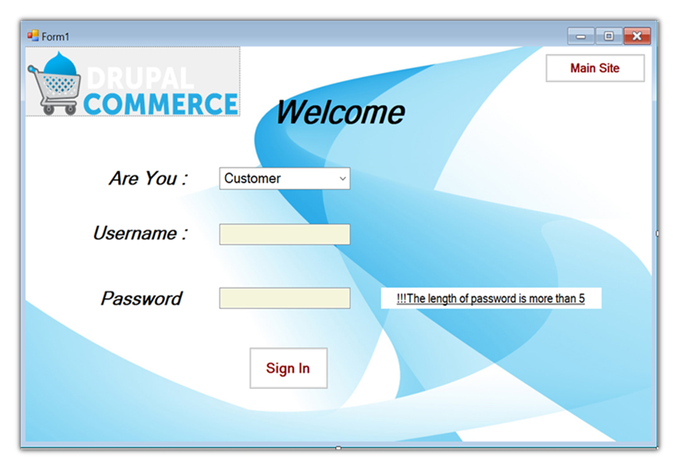
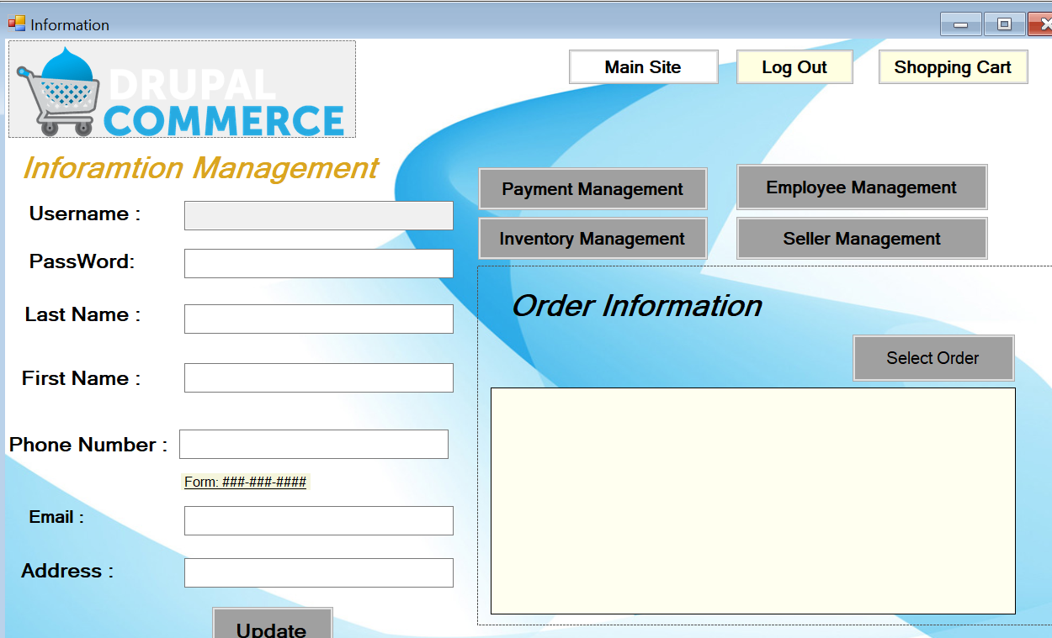
Transaction check employee self info(employee , supervisor)

Slide 33
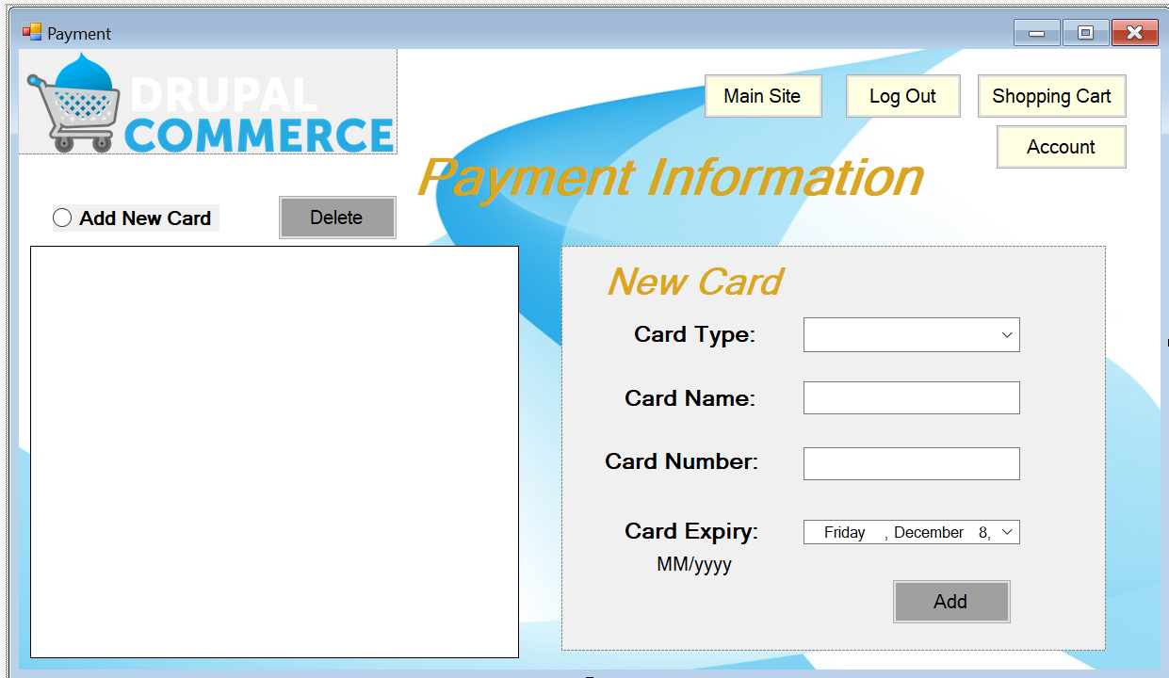
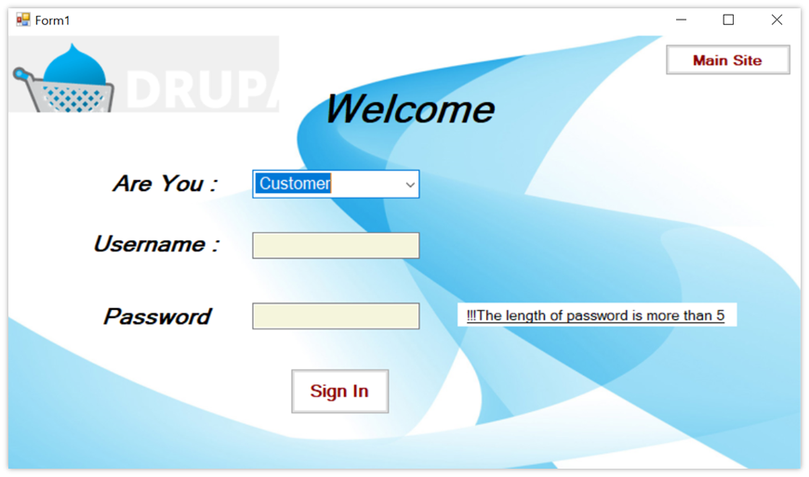
Transaction for log out (everyone)

Slide 34
Contribution page – thank you for listening!
User interface: Zhiyong Jing ; Lei Song
DataBase: XiangYing Liu

